Slide 1
Computer graphics sec1 Dr. Heba ElHadidi Eng. Sahar Magdy

Slide 2
Libraries
Graphics
Turtle
Open GL

Slide 3
Library | Definition
Graphic | it is a library built into the java programming language and is used to create simple Two-Dimensional graphics such as lines, shapes, and texts.
Turtle | it is a library built into the python programming language and is used to create simple Two-Dimensional graphics such as lines, shapes, and texts.
OpenGL | it is a library built into most programming language and is used to create complex and advanced Three-Dimensional graphics. It is also used in many applications and games.

Slide 4
Graphics Library
GraphWin: class that implement a window where you can draw in, provides some graphical objects as Point, Line, Circle, Oval, Rectangle, Polygon, Text, Entry.
GraphWin(title, width, height)
Graphic Objects: provided to draw in GraphWin as color, width, animation effects as: point – line – circle – oval – rectangle – polygon – text.

Slide 5
GraphWin
Function | Job
getMouse() or checkMouse() | allow user to click a mouse and return where the mouse was clicked as a point .
Close() | close on-screen window.
setBackground(Color) | change the background color of the window.

Slide 6
Graphic Objects
Point Methods
Function | Job
plot(x, y, ”color”) or Point(x , y) | draw a point.
setOutLine(color) | change the color of the point.
draw() | to show any object.

Slide 7
Graphic Objects
Line Methods
Function | Job
Line(point1, point2) | constructs a line segment from point1 to point2.
setWidth(pixels) | sets the width of the outline of the object to the desired number of pixels. (Does not work for Point.)
setArrow(endString) | sets the arrowhead status of a line. Arrows may be drawn at either the point, the last point, or both. Possible values of endString are "first", "last", "both", and "none". The default setting is "none".

Slide 8
Graphic Objects
Rectangle Methods
Function | Job
Rectangle(point1 , point2) | to draw a rectangle
setFill (color) | sets the interior of the object to the given color.
getCenter( ) | returns a clone of the center point of the rectangle.

Slide 9
Graphic Objects
Polygon Methods
Function | Job
Polygon(point1 , point2,…..) or Polygon([point1 , point2,…..]) | constructs a polygon with the given points as vertices. Also accepts a single parameter that is a list of the vertices.

Slide 10
Graphic Objects
Text Methods
Function | Job
Text (anchorPoint, textString) | constructs a text object that displays textString centered at anchorPoint. The text is displayed horizontally.
getAnchor ( ) | returns a clone of the anchor point.
setFace(family) | changes the font face to the given family. Possible values are "helvetica", courier", "times roman", and "arial".
setStyle(style) | changes font to the given style. Possible values are: "normal", "bold", "italic", and "bold italic".
setSize(point) | changes the font size to the given point size. Sizes from 5 to 36 points are legal.
setTextColor(color) | sets the color of the text to color. Note: setFill has the same effect.

Slide 11
Graphic Objects
Entry Methods
Function | Job
Entry(centerPoint, width) | constructs an Entry having the given center point and width. The width is specified in number of characters of text that can be displayed.

Slide 12
Tasks How can you create each of these shapes?

Slide 13
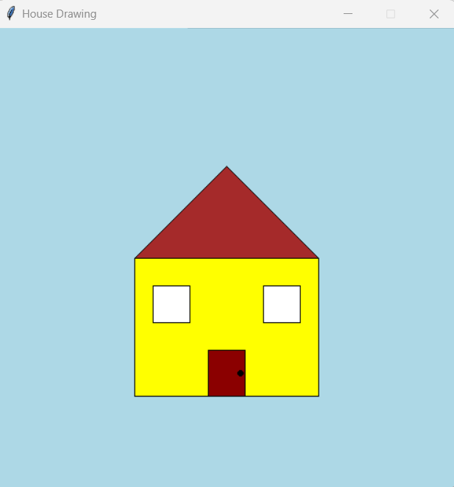

Slide 14
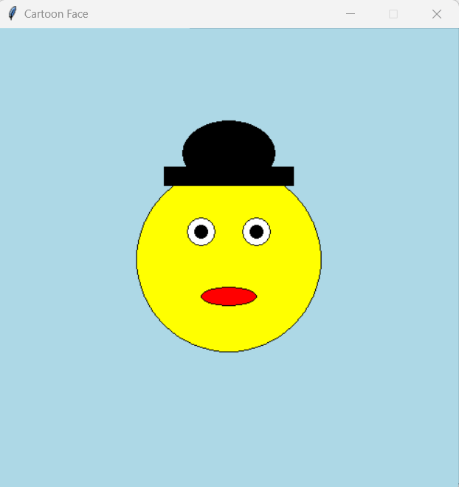

Slide 15
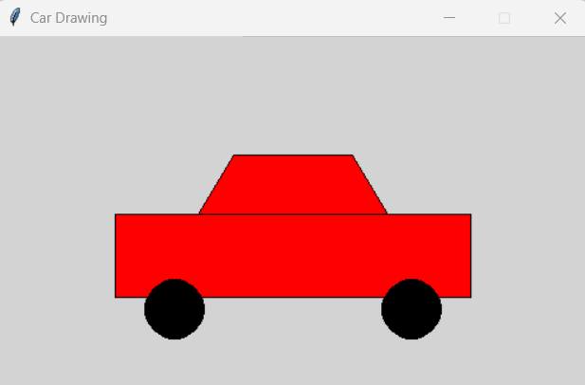

Slide 16
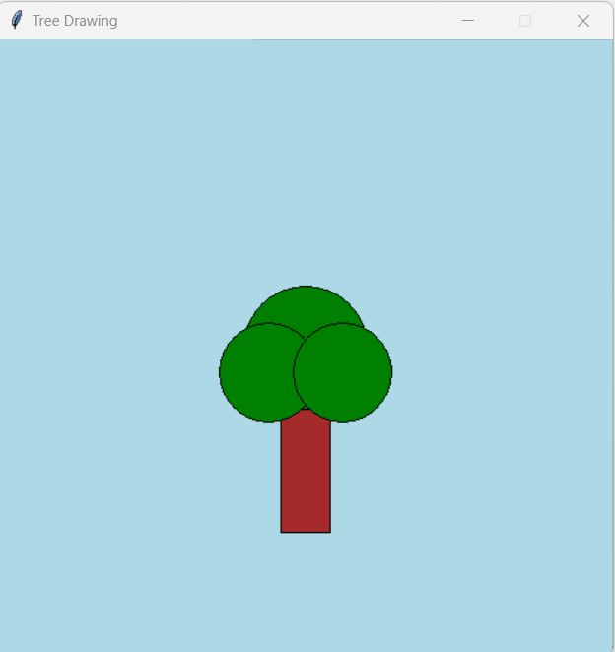

Slide 17
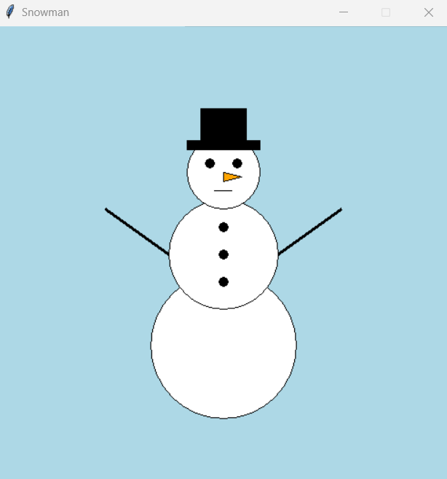

Slide 18
THANK YOU

